Slide 1
MA2012 Introduction to Mechatronics Systems Design (Lecture 8)
A/P Ang Wei Tech
Email: wtang@ntu.edu.sg
Tel: 6790-4911
Office: N3.2-01-04
CA Result
Class mean = A+

Slide 2
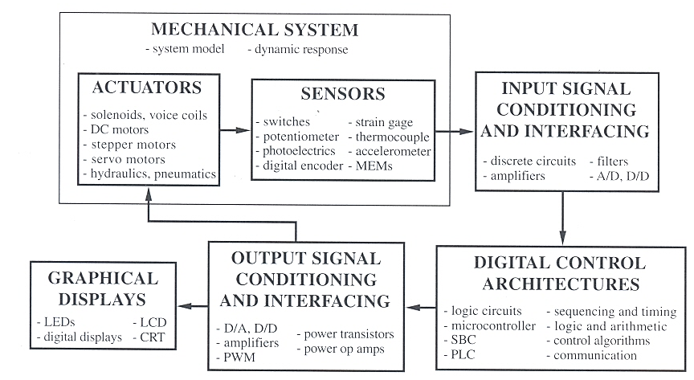
Lecture 1 – Introduction 
Mechatronics System Components & Examples: Car, Printer, etc.

Slide 3
Lecture 2 – Arduino UNO MCU 
ATMega 328 MCU
Number of bits, processor speed
Memory: RAM, EEPROM, Flash Memory
Memory allocation in different application scenarios
Other components
Digital I/O pins, ADC pins, power supply
Programming Environment: Arduino IDE
Connecting PC to Arduino Board
Bootloader Program

Slide 4
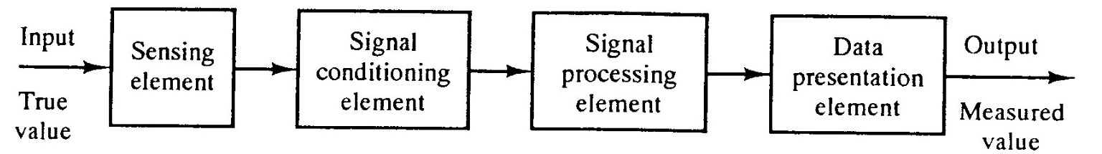
Lecture 3 – Sensors     
Digital Sensors
Switches, Incremental Encoder
Interfacing with Digital Sensors
Analog Sensors
Digital Output (e.g. Proximity sensor), Analog Output (e.g. Potentiometer), Digital and Analog Outputs (e.g. accelerometer)
Acquisition process and elements

Slide 5
Lecture 3 – Sensors     
Digitization of analog signal
Shannon sampling theorem, Nyquisit frequency, Aliasing
A/D Conversion, ADC
Successive Approximation, Flash Converter
Interfacing with ADC

Slide 6
Lecture 4 – Actuators     
Direct Current (DC) Motor
Construction
Brushed vs Brushless
Control
Pulse Width Modulation (PWM)
Inductive Kickback & Diode protection
Servomotor
Working principle
Control: Mark length

Slide 7
Lecture 4 – Actuators     
Solenoid
Construction & Control
Stepper Motor
Construction & Working Principle
Unipolar – 2 windings per phase, one for each direction of magnetic field
Bipolar – 1 winding per phase, needs a H-Bridge circuit to change direction
Control
Wave Drive / Single Phase
Two Phase Full Step
Two Phase Half Step
Microstepping

Slide 8
Lecture 5 – Signal Conditioning    
Signals & Noise
Deterministic vs random signals
Noise characteristics & sources
Signal-to-Noise Ratio
Input Signal Conditioning
Deflection Bridge: Quarter, Half, Full
Op-amps: Inverting, non-inverting, differential, voltage follower, voltage adder
Filters: Low Pass, High Pass
Averaging
Output Signal Conditioning
Digital-to-Analog Converter

Slide 9
Lecture 6 – Communications 
Interfacing with I/O devices
MCU-Initiated
Unconditional transfer, no handshaking
Conditional transfer (Polling), handshaking is required
Device-Initiated
Interrupt transfer, handshaking is required
Characteristics of Interrupt Service Routine (ISR)
Hardware interrupt in Arduino
Polling vs Interrupting

Slide 10
Lecture 6 – Communications     
Parallel vs Serial Communications
Universal Asynchronous Receiver Transmitter (UART)
Data transmission rate
Synchronous vs Asynchronous communications
I2C Bus and SPI Bus
Characteristics, Communication protocols
Advantages
Wireless communications
Bluetooth
WIFI

Slide 11
Lecture 7 – Mechatronics Systems     
Understand the task, define the problem
Sketch a functional block diagram
Decide & select mechatronics components (type, number, communication protocol, etc.) :
Digital control architecture
Sensors & input interfacing
Actuators & output interfacing
Display
Construct hardware prototype
Programme software / firmware

Slide 12
Examination
Date/Time/Venue: 07 Dec / 1:00 PM / Hall A
Format:
2h
Closed book
4 questions
Answer all
50% of Final Grade

Slide 13
Exam Scope & Question Types
Short questions on sensors, actuators, I/O devices and interfacing
Given a problem/task/scenario, identify suitable component(s) or techniques and explain choice
Circuit & Programming
Given a circuit, write sub-routines to fulfill certain task requirements.
Given a sub-routine, interpret what the codes are trying to do

Slide 14
Exam Scope & Question Types
Design of mechatronics systems with Arduino UNO MCU
Given a problem/task/scenario, design a mechatronics system: description and/or block diagrams
Interfacing Arduino UNO MCU with sensors and/or actuators
Given a datasheet(s) of sensor and/or actuator, answer short questions, sketch simple circuits, do simple calculations, write C++ codes, etc.

Slide 15
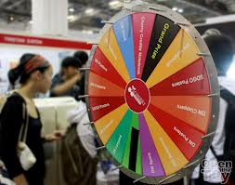
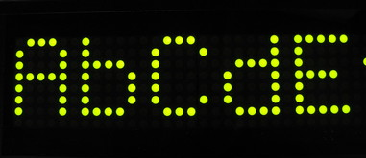
Exercise 1
You are to design a control system of a spinning lucky draw wheel at an amusement park.
When a participant presses a button, the wheel will spin at around 30 rpm; when the button is released, the wheel is allowed to spin freely until it stops.
There are 16 different prizes to be won. Your system has to automatically identify the sector at the 12 o’clock position and display the associated prize on a dot matrix display.

Slide 16
Exercise 1
Sketch a schematic block diagram to show your design of the control system for this application.
Indicate and describe clearly in your diagram all the required mechatronic components (Arduino UNO MCU, sensors, actuators, I/O devices, interfacing devices, power sources, etc.) and their relationships. You may assume the system uses a 12VDC battery pack.
Your answer need to specify only the component type, information on the make and model of components are not necessary

Slide 17
Exercise 1
12V
7V
12V
5V
5V / 7V regulator
Push Button
DC Motor spinning wheel
Arduino UNO MCU
DC Motor Driver
5V
5V / 7V
Encoder
Power Indicator LED

Slide 18
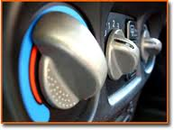
Exercise 2
You are to design an automatic temperature control system to keep a car warm.
There are two control settings: temperature & fan speed. Both settings has 3 levels of control: Low, Medium, High.
In the manual mode, you may independently set the level of temperature and fan speed.
In the automatic mode, you set the
level of temperature (L-M-H) and the
computer will adjust the heating coil
temperature & fan speed to reach and
maintain it within the desired
temperature range

Slide 19
Exercise 2
Sketch a schematic block diagram to show your design of the control system for this application.
Indicate and describe clearly in your diagram all the required mechatronic components (Arduino UNO MCU, sensors, actuators, I/O devices, interfacing devices, power sources, etc.) and their relationships. You may assume the car runs with a 24VDC battery.
Your answer need to specify only the component type, information on the make and model of components are not necessary

Slide 20
Exercise 2
24V
5V
7V
24V
DC Fan Motor
5V / 7V regulator
Temp Sensor #1
Arduino UNO MCU
DC Motor Driver
5V
24V
Heat Coil
Temp Sensor #2
Heat coil driver
5V / 7V
Power Indicator LED
5V
5V
Fan Speed Dial (pot)
Temperature Dial (pot)

Slide 21
Exercise 3
The application described in Ex. 2 requires 2 temperature sensors to be mounted in the car, one near the driver’s seat and the other one near the back row seat. Given the datasheet of Analog Devices TMP3x Low Voltage temperature sensor. Answer the following questions:

Slide 22
Exercise 3
Describe how can we use the SHUTDOWN function to minimize the power consumed by the temperature sensor when the car engine is off.
MCU sends a Logic 0 (LOW) to the SHUTDOWN pin
Which packaging type (SOT-23/SOIC_N/TO-92) should we choose?
SOIC_N or SOT-23. (See Datasheet pg 9, section Shutdown Operation)

Slide 23
Exercise 3
How would you interface this sensor with an Arduino UNO MCU? Describe in words and sketch a schematic diagram.
The temperature sensor Vout pin is connected to one of the Analog Input pins of Arduino UNO MCU
The Shutdown pin is connected to a Digital I/O pin.
7V
5V
Temp Sensor
Vout
Shutdown
Arduino UNO MCU
A0
D0

Slide 24
Exercise 3
If the car is designed for all weather conditions, i.e. –30 to +45°C, which model (35/36/37) should we choose? Why?
All models can be used but TMP36 should be chosen because the scale factor is rated in this temperature range, i.e. performance can be guaranteed.
If the car is designed for sub-tropical conditions, i.e. +5 to +30°C, and it is desirable to maximize the sensitivity, which model should we choose? Why?
TMP37. Because it is the most sensitive (20 mv/deg).

Slide 25
Exercise 4
The game in Ex.1 is changed such that only 1 out of 16 sectors will win the grand prize, and all others win nothing. The design of the system is such that a sensor senses no object (slit) when a prize is won.
Given the datasheet of Omron proximity sensor E2EM. Answer the following questions:
Al Strip (2.5 mm thickness)
Sensor
Slit (12x50mm)

Slide 26
Exercise 4
If the distance between the sensor and the rim of the wheel is 10mm, which model should you use?
E2EM-X30MX. Refer to pg 4 bottom right graph, see plot for Aluminum.
If it is required to send a LOW to a MCU when the slit is detected, should you choose NC or NO type?
NO. Because when the slit (i.e. no object) is detected, the output is LOW.
Discuss the trade-off of selecting shielded vs unshielded model.
Unshielded: longer sensing distance but more noise
Shielded: vice versa

Slide 27
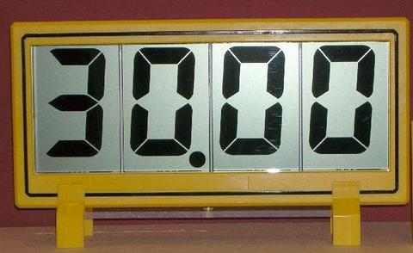
AY16/17 Q2
A mechatronics engineer implemented a measurement system using an Arduino UNO MCU. The measurement system has a digital temperature sensor and an analog accelerometer to monitor the conditions of a piece of equipment. The temperature sensor records the ambient temperature of at a sampling frequency of 10 Hz. A 4-digit Liquid Crystal Display (LCD) is used to show real-time measurement of the temperature (see Figure 1) with 2 decimal points. The accelerometer is used to measure the vibration of the equipment caused by movement activities in its vicinity and is sampled at 200 Hz.

Slide 28
AY16/17 Q2
An operator observes that the least significant digit of the LCD is fluctuating all the time while the ambient temperature is held constant. Explain the cause of this observation. (2 mark)
This fluctuation is caused by random or white noise.
The temperature sensor has a resolution of 12-bit and the sensing range is from 10 – 90°C. The fluctuation is only in the range of ± 1 bit from the true temperature. Given that the true temperature is 30.00°C, what are the 3 possible temperatures which the display will show? (9 marks)
12 bit is equivalent to 2¹² = 4096 levels
Temperature range = 90 – 10 = 80°C
Resolution = 80 / 4,096 = 0.02°C
The 3 possible temperatures to be displayed are 29.98, 30.00 & 30.02.

Slide 29
AY16/17 Q2
Suggest 3 possible ways to make the temperature reading shown on the LCD to stop fluctuating so frequently. (6 marks)
Any 3 of the following:
Use a lowpass filter
Perform a moving average
Display only 1 decimal point
Update display every minute (or any time period significantly longer than sampling period)
An analysis of a short period of recording by the accelerometer reveals that the signal is made up of a 1 Hz signal caused by a person walking pass the equipment, a 50 Hz noise caused by powerline hum, and random noise. Suggest how this powerline hum can be removed without affecting the 1 Hz signal. (3 marks)
To use a lowpass filter with a cut-off frequency between 10-40 Hz.
Or to use a bandstop filter centered at 50Hz.

Slide 30
AY16/17 Q2
Why is the powerline hum not observed in the temperature sensor recording? (3 marks)
Because the sampling frequency is lower than the Nyquist frequency to sense the 50 Hz powerline hum.
If a digital accelerometer is used instead of an analog one, would the powerline hum be still unobservable? (2 marks)
Yes

Slide 31
AY19/20 Q2
Name two advantages and two disadvantages of DC motors as compared with Stepper motors.
(4 marks)
Advantages of DC Motor vs Stepper Motor (any 2):
Easier to control in velocity control mode
Possible to control in torque control mode
Cheaper to implement in velocity control applications
Higher torque in high speed applications
Disadvantages (any 2):
Harder to control in displacement/position control mode
Lower holding torque in positioning applications
Lower torque at low speed applications
More expensive to implement in positioning applications

Slide 32
AY19/20 Q2
In general, a DC motor may be controlled in speed control mode or torque control mode. Explain how you can use an Arduino UNO MCU only (i.e. without a peripheral driver) to control a DC motor in these two control modes.
(4 marks)
Speed control mode: Not possible, need a driver
Torque control mode: not possible with Arduino UNO

Slide 33
AY19/20 Q2
When controlling a DC motor, it is mandatory to add a flyback diode in the circuit, as illustrated in Figure 2. Explain why this is necessary.
(4 marks)
The steady-state current though an inductor, cannot immediately go to zero when the switch (physical or transistor) is opened. The changing current induces a voltage across the inductor, making the potential of the ground end of the inductor greater than the Vcc end, and will cause the switch to ‘blow up’. Kickback or flyback diode protects the switch from blowing up.

Slide 34
AY19/20 Q2
There are several ways to control a unipolar Stepper motor. State one advantage of each of the three popular control methods: Wave Drive, Two Phase Full Step and Two Phase Half Step.
(3 marks)
Wave Drive: Simplest to control
Two Phase Full Step: Highest holding torque
Two Phase Half Step: Highest positioning resolution/accuracy

Slide 35
AY19/20 Q3
A geologist wishes to map the profile of a cave with a river running through it. As illustrated in Figure 5, his idea is to use a remote control boat to go upstream, carrying a laser scanning device.
The laser scanning device is made up of an Arduino UNO MCU, a Flash memory module, a pair of laser range sensors, each attached to a tilt motor which has a range of 135 degrees.
The boat is equipped with a battery powered power-supply (also provide power to the laser scanning device), a rudder steering motor, a motor with propeller, an ultrasonic speed sensor to measure the boat speed, an Arduino UNO MCU and a wireless communication module.
The remote controller consists of an Arduino UNO MCU, a wireless communication module, a battery and two potentiometers for speed and steering control.
Sketch a schematic block diagram to show your design of the control systems for this application. Indicate and describe clearly in your diagram all the mechatronic components (Arduino UNO MCU, sensors, actuators, I/O devices, interfacing devices, power sources, etc.) and their relationships to each other. You may make appropriate assumptions to add new components (e.g. switches), but you need to state them clearly.
Your answer need to specify only the component type. Information on the make and model of components are not necessary.
(25 marks)

Slide 36
AY19/20 Q3

Slide 37
Homework
AY1516 Q4
AY1617 Q4
AY1718 Q2
AY1920 Q4
AY2021 Q4
AY2122 Q3
AY2223 Q4
Solutions shall be posted on 30 Nov
Good Luck!

